Slide 1

Flight price prediction
IEEE Mansoura (CS branch) Data Science circle
Data Pirates

Slide 2

About Us
Amira Sultan
Menna Ayman
Yousef Khaled
Data Pirates
Data
Pirates

Slide 3

outline
Introduction
Business of data understanding
Our key findings
Data preparation and processing techniques used
Model approaches and evaluation
Data
Pirates

Slide 4
Introduction
Booking a flight may be a stressful thing
Buyers may be not aware of factors that influence flight prices
Through flight price prediction you can predict the price from previous sell history, and we make this prediction using machine learning
Data
Pirates

Slide 5
Business data understanding
Airline : The name of the airline.
Date of Journey : The date of the journey.
Source : The source from which the service begins.
Destination : The destination where the service ends.
Route : The route taken by the flight to reach the destination.
Department Time : The time when the journey starts from the source.
Arrival Time : Time of arrival at the destination.
Duration : Total duration of the flight.
Total Stops : Total stops between the source and destination.
Additional Info : Additional information about the flight.
Price : The price of the ticket.
Data
Pirates

Slide 6
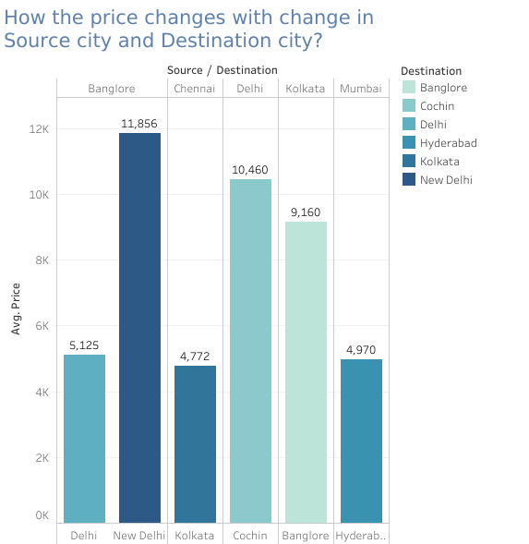
Business data understanding
Highest average price from Bangalore to New Delhi.
Lowest average price from Chennai to Kolkata.
Data
Pirates

Slide 7
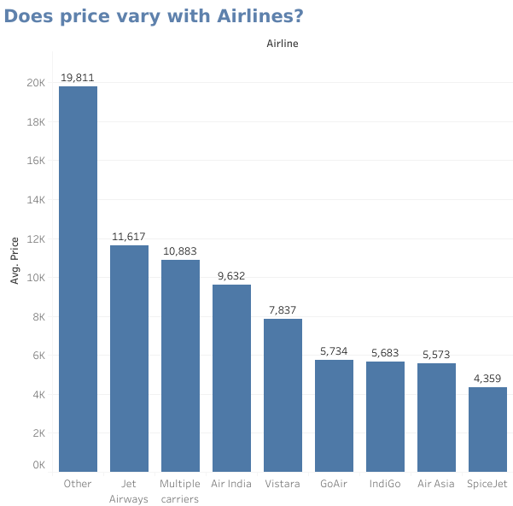
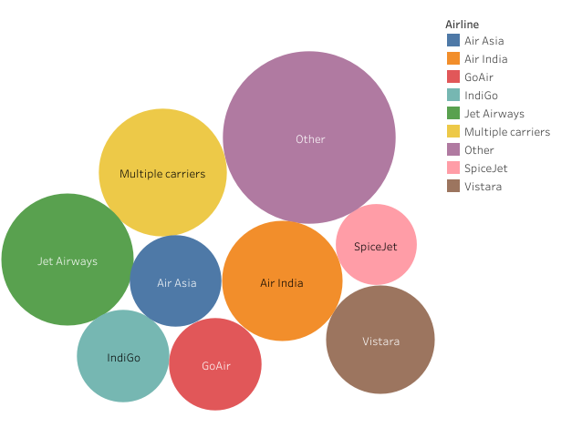
Business data understanding
Data
Pirates

Slide 8
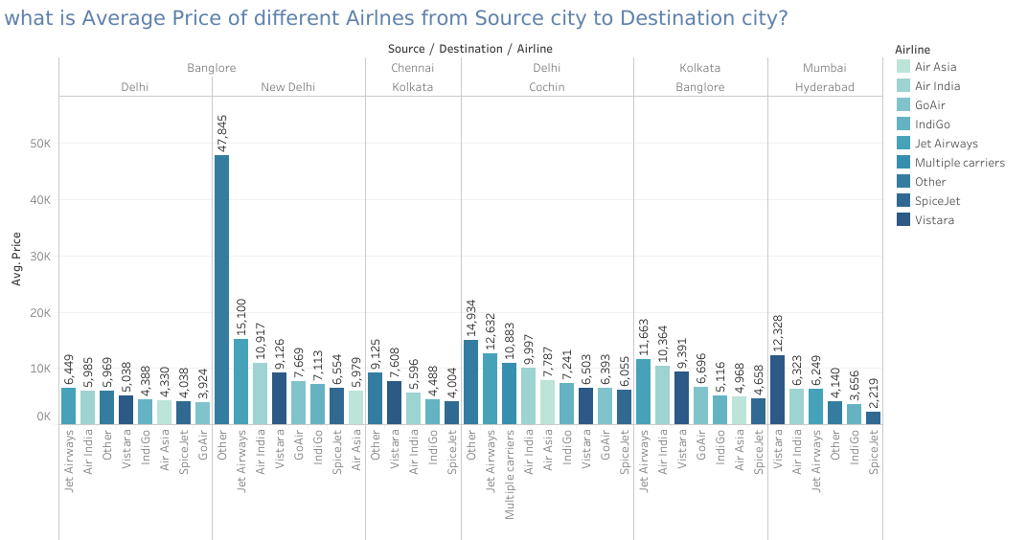
Business data understanding
Data
Pirates

Slide 9
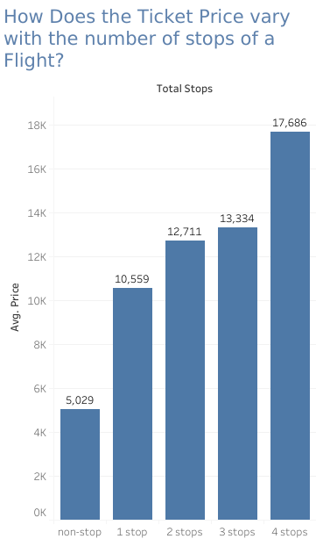
Business data understanding
According to number of stops:
Highest average price is for 4-stops between the source and destination.
Lowest average price is when there is no stops during the flight.
Data
Pirates

Slide 10
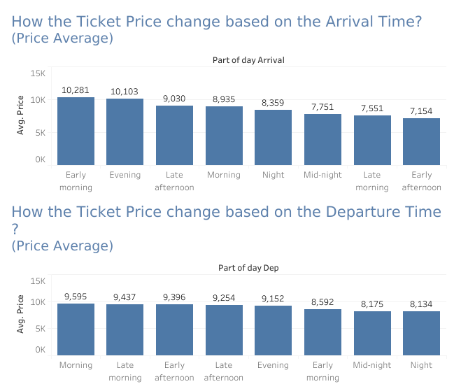
Business data understanding
According to part of the day:
Arrival:
Highest average price is 10,281$ at Early morning
Lowest average price is 7,154$ at Early afternoon
Department:
Highest average price is 9,595$ at Morning
Lowest average price is 8,134$ at Night
Data
Pirates

Slide 11
Data preparation and processing techniques used
Replacing any low values within categorical columns with new values.
Dealing with duplicates.
Dealing with null values.
Converting any column that infers to a time or date into a python date format And splitting it into two columns for hour and minute or for day and month, respectively.
Handling categorical data and converting it into numerical manually.
Data
Pirates

Slide 12
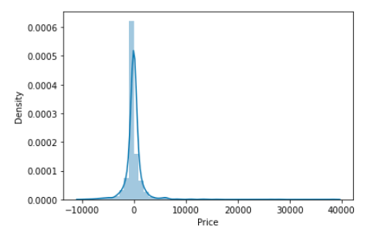
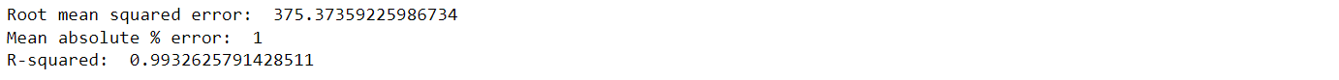
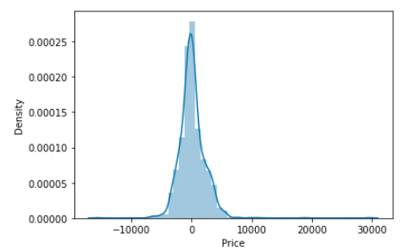
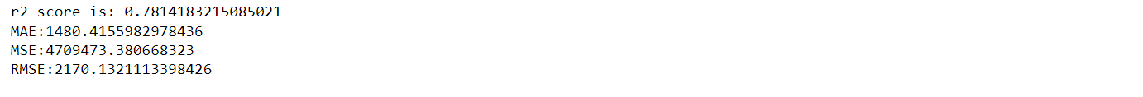
Model approaches and evaluation
Decision Tree Regressor
Gradient Boosting regressor
Data
Pirates

Slide 13
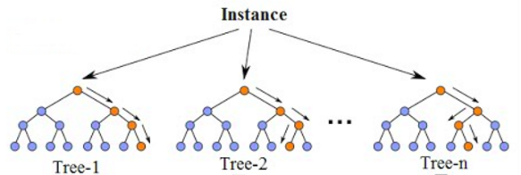
Model approaches and evaluation
We used sklearn module for training our random forest regression model, specifically RandomForestRegressor.
Approaches & steps:
1-Pick at random K data points from the training set.
2-Build the decision tree associated with those data point.
3-Choose the number Ntree of trees you want to build.
4-For a new data point, make each one of your Ntree trees predict the value of Y for the data point, and assign the new data point in the average all of the predicted Y values.
Data
Pirates

Slide 14
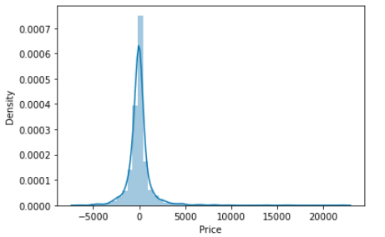

Model approaches and evaluation
we selected parameters for our model:
n_estimators = 220 ,
max_depth = 20 ,
max_features = auto ,
random state = 42
Data
Pirates

Slide 15
QA
Data
Pirates

Slide 16


